Slide 1
CIGRE NGN Women In Energy (WiE)
Roundtable Discussion
A Webinar on 26th October 2021
CIGRE NGN was established to connect younger generations with senior generations to ensure that everyone’s opinions and views are heard. We bring a fresh look to an ageing industry and more importantly, to give inexperienced engineers opportunities to learn from experts within the industry.
Two CIGRE NGN groups, Italy and UK will host an Inclusion and Diversity webinar on 26th Oct, 1-2:30pm BST, 2-3:30pm CEST. The event will start with two presentations along with some key insights for gender equality from Italian NGN followed by UK NGN.
After that, a panel discussion with 8 members will follow, 3 panellists from UK, 1 guest from Denmark, 3 panellists from Italy. The panellists will have to give their views on topics related to gender and salary gaps, impact of maternity leave on the workplace, low STEM participation, lack of female representation on boards, biggest achievements and opportunities as well as potential ways forward. Jingyi Wan, international lead of the CIGRE NGN International and UK Committee, will steer the panel discussion and provide the concluding remarks.
Date and Time: 26th Oct 2021, 13:00-14:30 (BST), 14:00-15:30 (CEST)
Platform: Go To Webinar
Registration: https://attendee.gotowebinar.com/register/8718193041381851151
Agenda
13:00 - 13:10 Opening and Presentation by CIGRE Italy NGN
13:10 - 13:20 Presentation by CIGRE UK NGN
13:20 - 13:50 Panel discussion I: Career path for WiE
13:50 - 14:20 Panel discussion II: Beyond Career
14:20 - 14:30 Q&A (Time might slightly vary)
14:30 - 14:35 Close

Slide 2
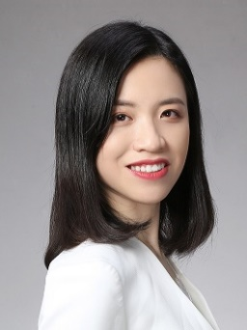
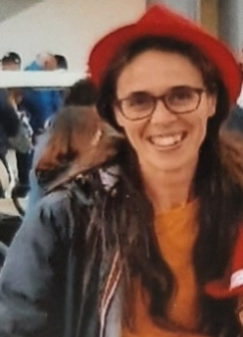
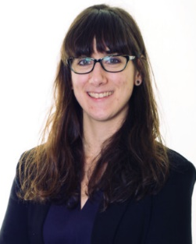
Speaker Bio:
Jingyi Wan is a Senior Engineering Consultant for HV Cable Systems at Arcadis. Technical expertise is on onshore/offshore Cable Systems design, manufacture and technical advisory at various stages of project life cycle. Before working as a consultant, she worked as a product development engineer for a subsea cable supplier. Worked with a team to qualify and supply the cables for the industry’s first commercial 66kV array cable project. She is the UK Representative of CIGRE NGN International Executive Committee, also a young expert member of CIGRE working groups on B1 insulated cable.
Jingyi Wan
(UK, Moderator)
Arianna Guarneri works in Rome for the Italian Transmission System Operator (TSO), Terna since 2007, dealing with Environmental Protection, Authorisation and Connection Procedures to the High Voltage Electric Grid, Electric and Magnetic Fields (EMF’s Reference person in Terna). In 2018 she qualified as well as Envision SP (Envision Protocol for Sustainable Infrastructure). Before working in Terna she worked 4 years in characterization and remediation of contaminated sites (brownfields, landfills). She is member of Technical Committees in Technical Committee TC 106 Methods for the assessment of electric, magnetic and electromagnetic fields (EMFs) associated with human exposure and member of the EMF working group in ENTSO-E (European Network of Transmission System Operators for Electricity). Member of CIGRE since 2007, participating in EMF’s Working Groups, she is Women in Cigré Liaison Lead in CIGRE Next Generation Network (NGN).
Arianna Guarneri
(Italy, Presenter & Panellist)
Kelly joined the R&D UK Centre of EDF Energy in June 2020. She specialises in optimal valuation of energy storage co-located with renewables and long-term electricity price forecasting, with her products being provided to Pivot Power. Previously, she was working as a Modelling Analyst at Energy Systems Catapult, with main projects in energy storage, power system economics and second-life batteries. She also holds a PhD in battery storage, which was completed in the Centre for Doctoral Training in Power Networks of The University of Manchester (UoM). Currently, she is the vice-chair of the IEEE PES UK&I Women in Power Network, the project manager of Cigre’s Women Network, the digital lead of EDF Women’s Network and she also serves as a data science instructor at SisterAnalyst.
Angeliki Loukatou
(UK, Presenter & Panellist)

Slide 3
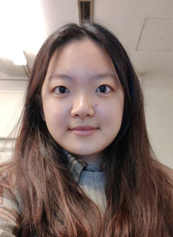
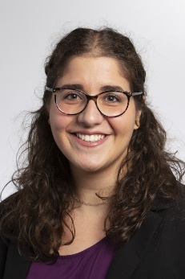
Speaker Bio:
Siva Kaviya, Trichy Siva Raman is a Power System Software Engineer working for the IPSA Software Team within the scope of Networks & Innovation Team of TNEI, based in Manchester. She has over 2+ years of professional work experience in Java Development followed by six years of Academics Experience in the field of Power Systems and Smart Grids with a good understanding of the European Energy Markets. She also has significant experience working with developing tool kits and software required for Power System Engineering Domain. She is now working for the CIGRE UK NGN Events Committee.
Siva Kaviya Trichy Siva Raman
(UK, Panellist)
Qinghua Han is a PhD student in Materials for Demanding Environments Doctoral Training Centre at the University of Manchester. Her project focuses on the electrical insulation systems for electric aircraft. She attained the master degree in Advanced Engineering Materials from the University of Manchester. Her principal research interests are to improve the insulation system for high voltage equipment by adopting high dielectric strength gases. She is now the membership lead for CIGRE UK NGN.
Qinghua Han
(UK, Panellist)
Daniela Pagnani is Chair of CIGRE NGN Denmark steering committee. Since 2019, she is with Ørsted and Aalborg University as Industrial PhD researching on black start capabilities of offshore wind farms.
She received the M.Sc. degree in electrical power systems and high voltage engineering from Aalborg University in 2019, and the B.Sc. degree in industrial engineering (electrical specialisation) from University of Cassino and Southern Lazio (Italy) in 2017. Her current research interests include black start by renewable energy sources, power system restoration, grid-forming control of converters, battery energy storage systems and wind turbines, system modelling and simulations.
Daniela Pagnani
(Denmark, Panellist)

Slide 4
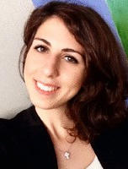
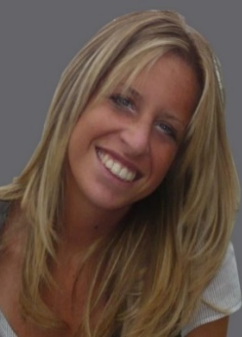
Speaker Bio:
Giulia Gemma Pancaro is an Electrical Engineer at Terna, the Italian Trasmission System Operator. She has been working as planning and control expert in O&M field since 2020. Before this role, she worked for an automotive company as motor control software developer, where she focused her studies on PWM algorithms
Giulia Gemma Pancaro
(Italy, Panellist)
Patrizia Fabozzi is an Environmental Engineer working in Health, Safety & Environment field at Terna Rete Italia. She is involved also in management requirements major-accident hazards legislation for some storage pilot plants, located in the South of Italy. Before this role, she worked for the same company for negotiations and relationships with local authorities to determine location, mitigation and compensation of new power lines and electrical stations, as well as supporting for the authorization phase. She begun her working experience in renewable resources, as project engineer of wind farms, following authorization iter for the construction of big and mini wind power plants.
Patrizia Fabozzi
(Italy, Panellist)
Beatrice Giachi is a Senior Project Engineer in Terna, the Italian Transmission System Operator. The main experience is in design and execution of complex project concerning to civil construction of electrical stations, both in green and brownfield. She has been working for the company since 2010 based in Florence, where she lives with her family and two daughters. Before this role she had been worked for the Health and Safety department and started her professional experience in 2006. The main expertise are in activity of planning, supervision and coordination of projects, with particular attention to the respect of regulations, codes, standards, constraints and variables involved.
Beatrice Giachi
(Italy, Panellist)

